Slide 1
AIST2010 project demonstration
A rhythm game by sound control
Cheng Ka Pui (1155125534)
Lam Puy Yin (1155126240)

Slide 2
What we used
Language: Python
Main Libraries: Librosa, Pygame and PyAudio

Slide 3
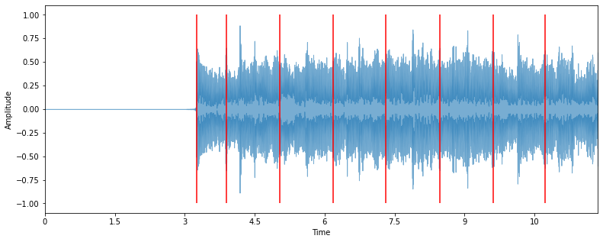
Librosa
Used for detecting onset function for track
librosa.onset.onset_detect(x, sr=sr, delta = 0.2, wait = 10)
delta = threshold (from the root mean square of amplitude) to be onset
wait = samples passed before finding another onset

Slide 4
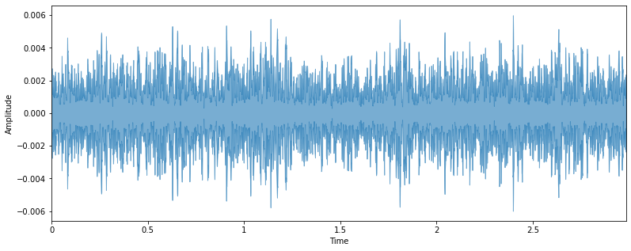
Pyaudio
Used for audio recording
record = pyaudio.PyAudio()
self.stream = record.open(format=audioFormat, channels=audioChannel, rate=audioRate, input=True, frames_per_buffer=CHUNK)

Slide 5
Pyaudio
rate: Sampling rate
channels: Number of channels
format: Sampling size and format (16 bit int in our case)
input: Specifies whether this is an input stream
frames_per_buffer: Specifies the number of frames per buffer (CHUNK = 2048)
record.open(format=audioFormat, channels=audioChannel, rate=audioRate, input=True, frames_per_buffer=CHUNK)

Slide 6
Pyaudio
audioDataBuffer = self.stream.read(CHUNK)
sample saved as a buffer
k = max(struct.unpack('2048h', audioDataBuffer))
unpack buffer with its format, return the maximum value to k
amplitude of that instance is collected (k)

Slide 7

Pyaudio
k will be used to detect changes in amplitude
ie. detecting attack of the envelope
when comparing with previous frame’s amplitude value (old_k)
if the amplitude difference is significant:
an attack!
onset is detected

Slide 8
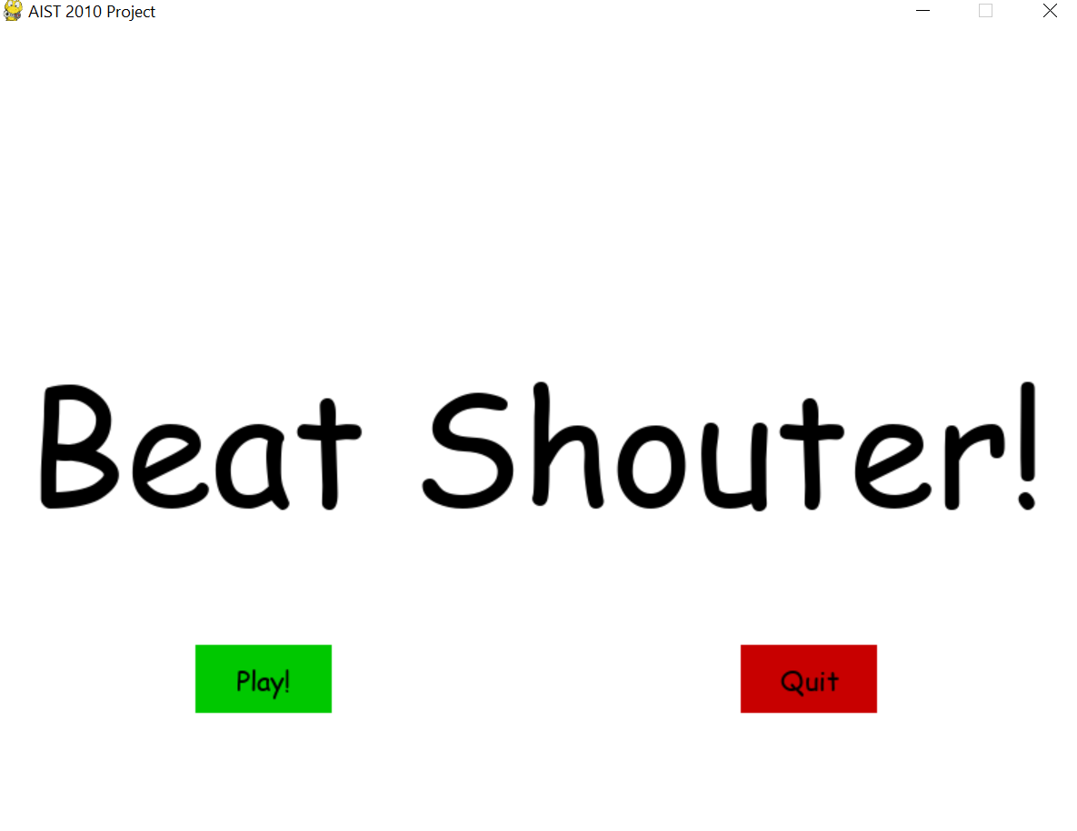
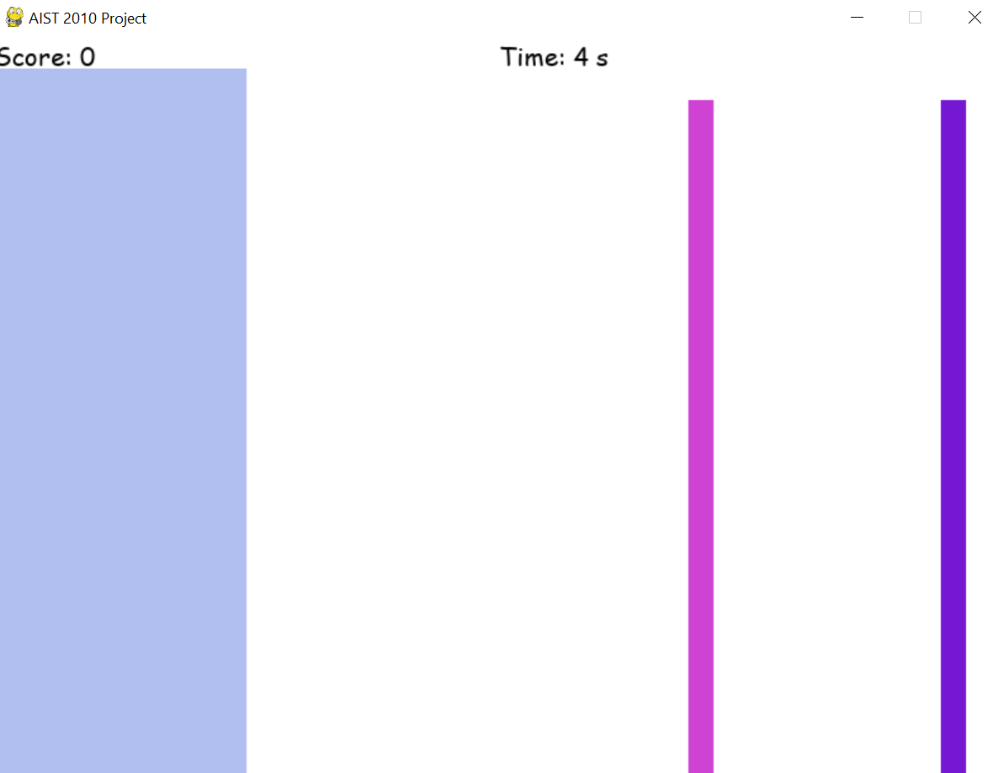
Pygame
Use for interactive display
Interface for input and output
Ie. Hit and get scores
score dsiaply
time dsiaply
onsets
hit detection area
Notes:
have basic rythm game concept

Slide 9
Challenges
Real time detection is difficult
(direct onset detection is not feasable)
Detection delay
(affect game experience)
No multi-processing between pygame and pyaudio for recording
(the game will stop moving if we record throughout the track)

Slide 10
Thank you

